Slide 1
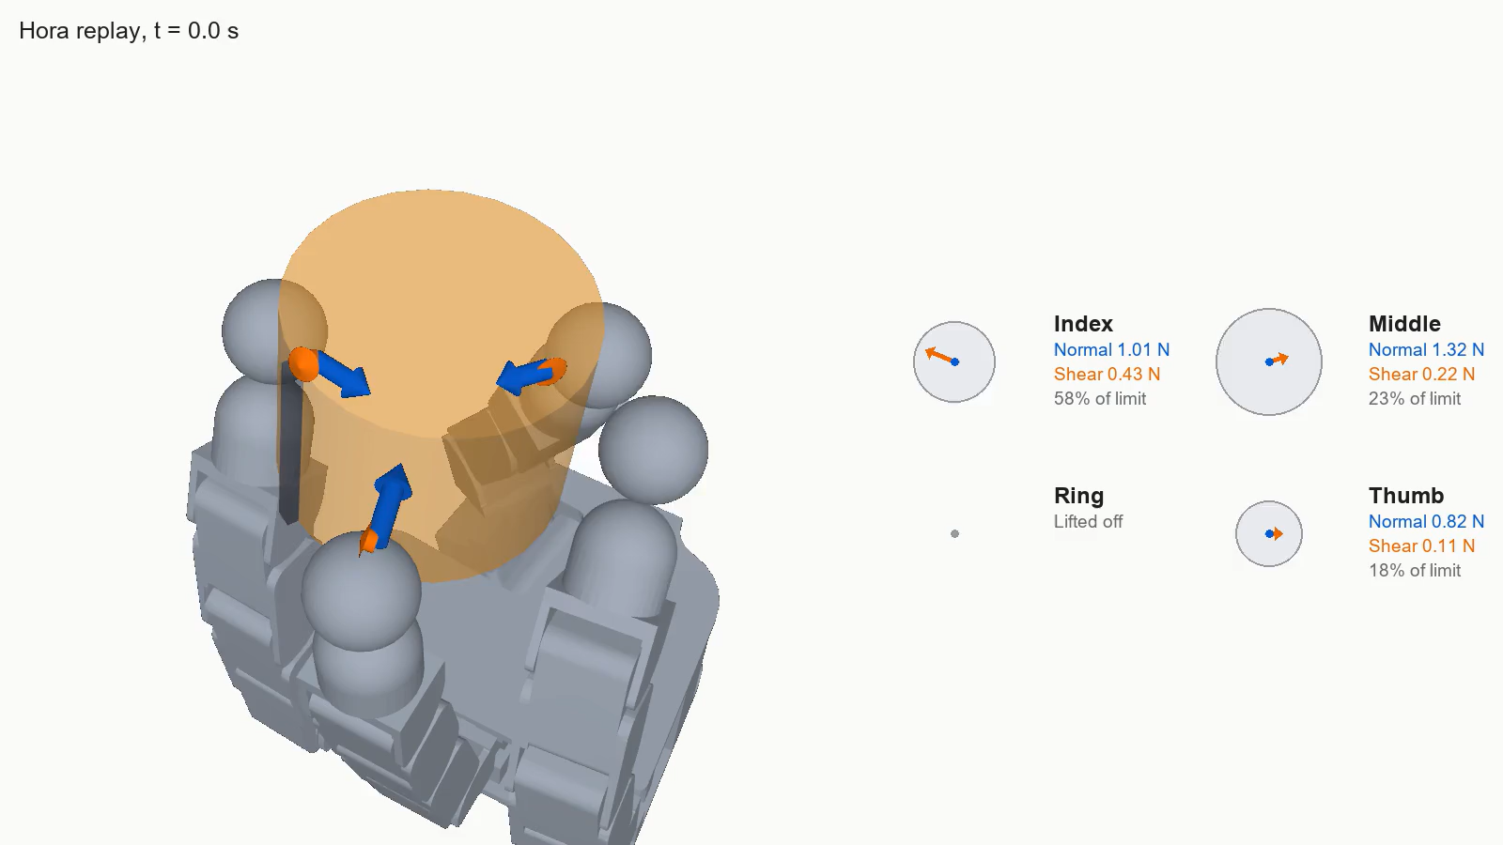
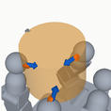
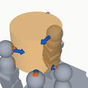
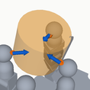
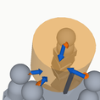
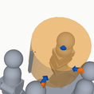
What the turning asks of each finger
Hora (RL policy) on an Allegro hand, turning a cylinder in simulation at 43 degrees per second. Replayed from its log.
■ Normal force
■ Shear
5 snapshots: Targets for manipulation re-enactment feasibility
Snapshot 1 saved: positions and forces, as targets.
Snapshot 2 saved: positions and forces, as targets.
Snapshot 3 saved: positions and forces, as targets.
Snapshot 4 saved: positions and forces, as targets.
Snapshot 5 saved: positions and forces, as targets.
Notes:
Hora replay, with five snapshots saved
Hora, a published learned policy on an Allegro hand, turns a cylinder in simulation. We replay it from its log. Normal forces are read from the simulator's contacts. Shear is derived from the object's motion and shared between fingers; this is one consistent split, not the only one.
Source: data/rl_logs/hora_seed42_30s*.npz, split by tools/hora_force_split.py.
Clip: clips/shot01.mp4, 0.00 to 20.37 s of hora.mp4

Slide 2
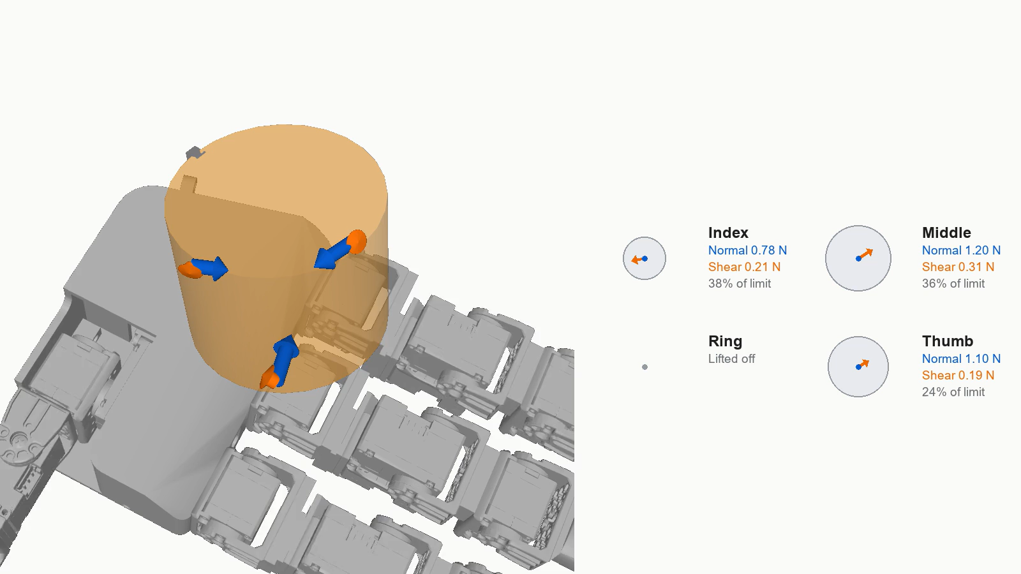
Snapshot 1, frozen
Snapshot 2, frozen
Snapshot 3, frozen
Snapshot 4, frozen
Snapshot 5, frozen
Is another hand capable of the manipulation?
A different hand (LEAP) applying the same normal and shear force at the same location to within a small toelrance
Snapshot 1: fitting.
Snapshot 1: green.
Snapshot 2: fitting.
Snapshot 2: amber.
Snapshot 3: fitting.
Snapshot 3: green.
Snapshot 4: fitting.
Snapshot 4: green.
Snapshot 5: fitting.
Snapshot 5: green.
Notes:
LEAP fitted to the five Hora snapshots
Seen from the same camera as the Hora replay. Each snapshot is frozen and checked on its own against the saved position and force targets. No hand is simulated doing the turn. Fingers are paired with contacts freely, whichever pairing reaches best. Every fingertip touch is on LEAP's soft pad: limiting the check to the pads gives exactly the same result. Poses are schematic: parts of the hand pass through the cylinder and through each other.
Source: inputs_7nov/hora/follow_leap__hora_seed42_five_snapshots.json; the pad-only check is in checks_9nov/hora_leap_pads/, from tools/run_follow_snapshots.py, which mirrors the per-frame loop of follow.py with a sphere at each contact. It is not the banked check.
Clip: clips/shot02.mp4, 20.37 to 30.37 s of hora.mp4

Slide 3
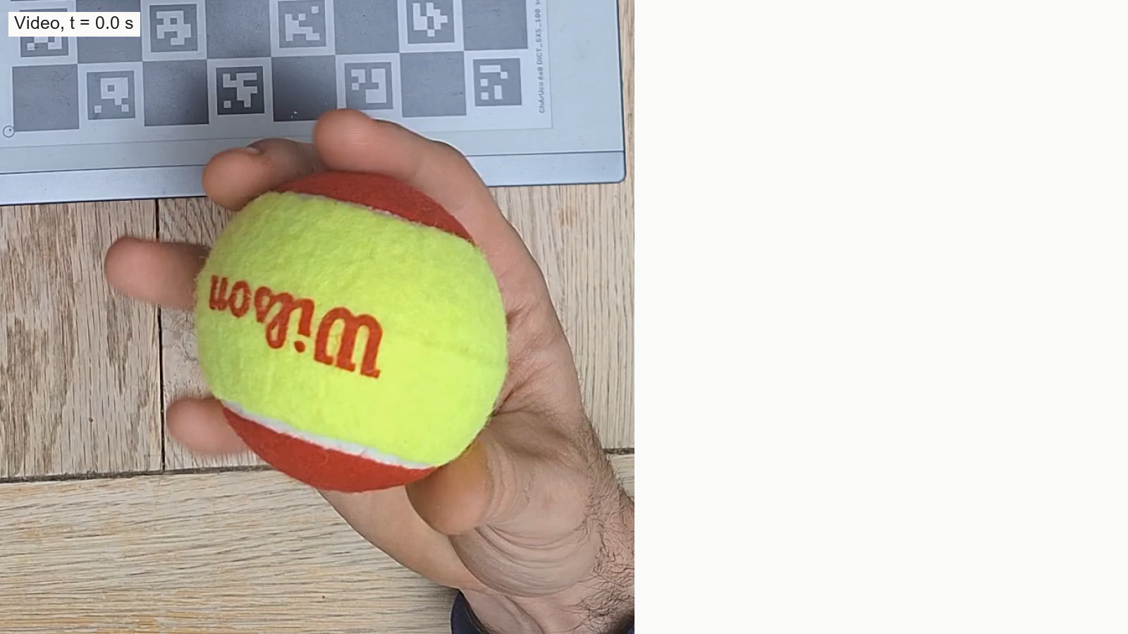
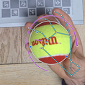
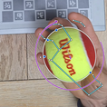
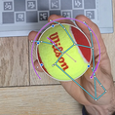
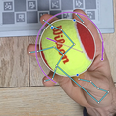
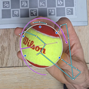
Transfer from human demonstration
Turning a tennis ball, about 156 degrees per second. Video, at normal speed.
Force is derived from ball mass and motion (not directly measured as in simulations).
Snapshot 1. Saved: where the ball is, which fingers touch, and how it turns: 121 degrees per second.
Snapshot 2. Saved: where the ball is, which fingers touch, and how it turns: 117 degrees per second.
Snapshot 3. Saved: where the ball is, which fingers touch, and how it turns: 242 degrees per second.
Snapshot 4. Saved: where the ball is, which fingers touch, and how it turns: 179 degrees per second.
Snapshot 5. Saved: where the ball is, which fingers touch, and how it turns: 173 degrees per second.
Snapshot 1: the tracked hand and ball.
Snapshot 2: the tracked hand and ball.
Snapshot 3: the tracked hand and ball.
Snapshot 4: the tracked hand and ball.
Snapshot 5: the tracked hand and ball.
Notes:
Video of a person turning a tennis ball, pausing at five snapshots with the tracked hand and ball
Recorded video at normal speed. The wireframe is the joints the cameras tracked; hidden joints are left out. The turn is measured from the tracked ball, relative to the palm. No sensor measured forces here. The turn's axis is drawn faint where the ball hides it; the panel gives how far it is from pointing straight into or out of the picture.
Source: data/leaders/tennis_new_cup_take3_handframe__nframesfix.json.
Clip: clips/shot03.mp4, 0.00 to 22.37 s of human_allegro.mp4

Slide 4
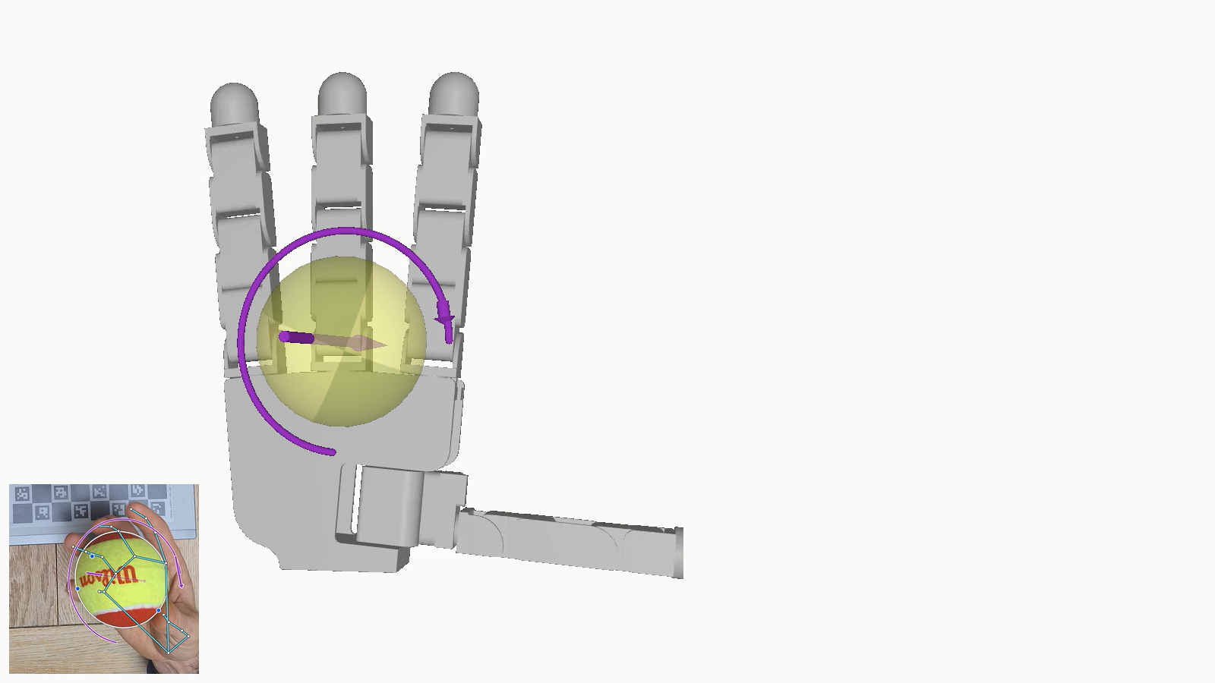
Human -> Robotic feasibility
Checks on Allegro hand, which has no little finger, so the person's little-finger contact is left out of both checks. Other fingers are paired
■ Position check: green. Every other contact reached.
■ Turning check: green. Index, middle, ring and thumb can hold the ball inside friction and joint strength
The touching fingers' joints can follow the ball's surface motion at their contacts.
Snapshot 1: fitting.
Snapshot 2: fitting.
Snapshot 3: fitting.
Snapshot 4: fitting.
Snapshot 5: fitting.
Mass and friction assumed. Comparative, not predictive.
Notes:
Allegro fitted to the five human snapshots
Seen from the phone's side, as in the video. Two separate checks on each frozen snapshot. The position check is follow.py with the forces set to zero. The turning check asks whether the touching fingers can hold the ball inside friction and joint strength, and how much torque they have to spare about its turn. The ball's mass and friction are assumed. Each finger is paired with the person's finger of the same name. Allegro has four fingers, so the person's little-finger contact is left out of both checks and not counted as a miss. The check chooses where to place the hand; here its palm is on the same side of the ball as the person's. Poses are schematic. The panel warns that torque to spare can be overstated, because the model sets no limit on the load a joint end stop carries.
Source: checks_9nov/position_turning_allegro.json and checks_9nov/follow_allegro__*no_little__position_only.json, from tools/run_follow_named_pairing.py then tools/position_turning_check.py.
Clip: clips/shot04.mp4, 22.37 to 37.37 s of human_allegro.mp4

Slide 5
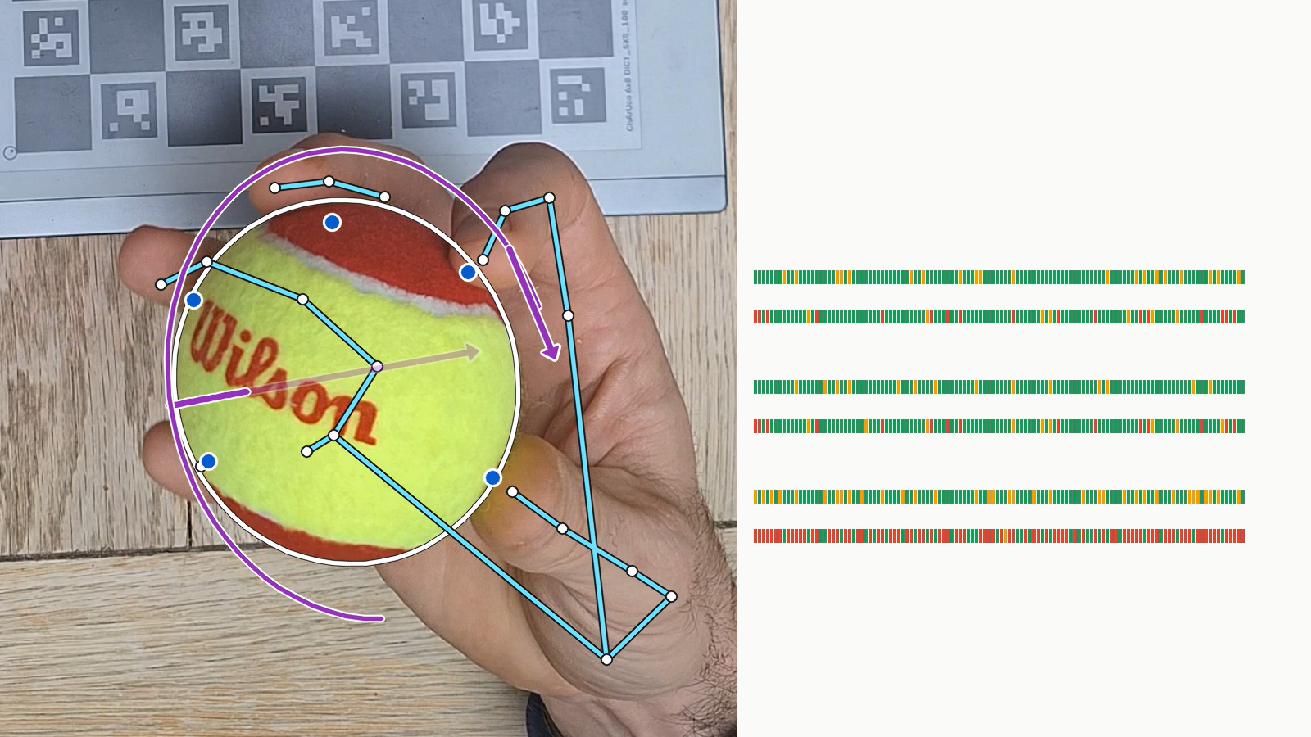
Every frame the checks looked at
Allegro
Position check: 100 green, 20 amber, 0 red of 120
Turning check: 96 green, 7 amber, 17 red of 120
LEAP
Position check: 106 green, 14 amber, 0 red of 120
Turning check: 96 green, 9 amber, 15 red of 120
Shadow
Position check: 84 green, 36 amber, 0 red of 120
Turning check: 35 green, 1 amber, 84 red of 120
Notes:
Counts for every frame, Allegro, LEAP and Shadow
120 frames across the take, each frozen and checked on its own. Allegro and LEAP are checked against the four contacts they have fingers for; Shadow against all five. No frame is red in any hand's position check. Shadow reaches the contacts, but in most frames its touching fingers cannot hold the ball through the turn. Red means not by this method at this pose, not that the hand can never do the task. Green in the turning check is a low bar: the turn itself needs little torque. The turning check was built for this film and is not the banked method.
Source: checks_9nov/position_turning_{allegro,leap,shadow}.json; counts printed by tools/count_position_turning.py.
Clip: clips/shot05.mp4, 37.37 to 44.37 s of human_allegro.mp4

Slide 6
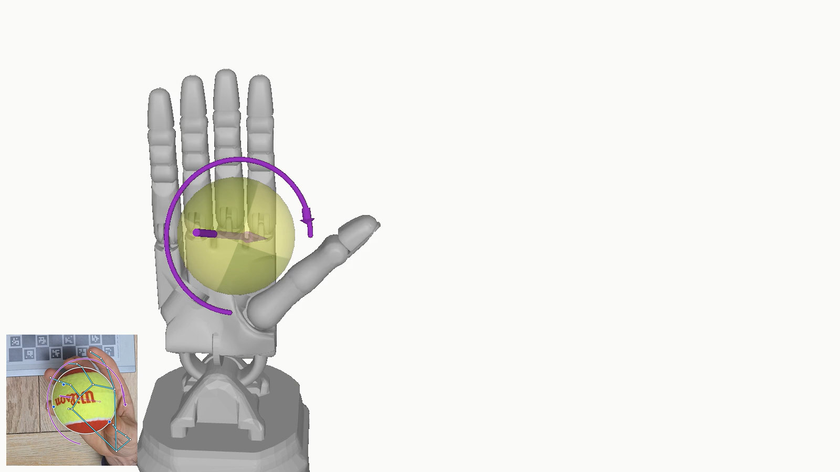
On Shadowhand
The touching fingers' joints can follow the ball's surface motion at their contacts.
Shadow has trouble producing lateral force to rotate the ball at each point of contact
Snapshot 1: fitting.
Snapshot 2: fitting.
Snapshot 3: fitting.
Snapshot 4: fitting.
Snapshot 5: fitting.
Mass and friction assumed. Comparative, not predictive.
Notes:
Shadow fitted to the five human snapshots
Shadow has a finger for each of the person's five contacts, each paired with the finger of the same name. Seen from the phone's side, as in the video. The same two checks as for Allegro. At these five snapshots its turning check is green in four of five, but across all 120 frames it is red in most; the five snapshots fall where Shadow does well, so the counts give the fairer picture. Poses are schematic.
Source: checks_9nov/position_turning_shadow.json and checks_9nov/follow_shadow__*position_only.json (copied unchanged from checks_7nov_b/); snapshot verdicts in parts/human_shadow_near_e2.log.
Clip: clips/shot06.mp4, 22.37 to 37.37 s of human_shadow.mp4

